Slide 1

BD9E151NUX-E2EVK-101 Measurement Report
September 22, 2014
Hosted by: Xuan Dang

Slide 2
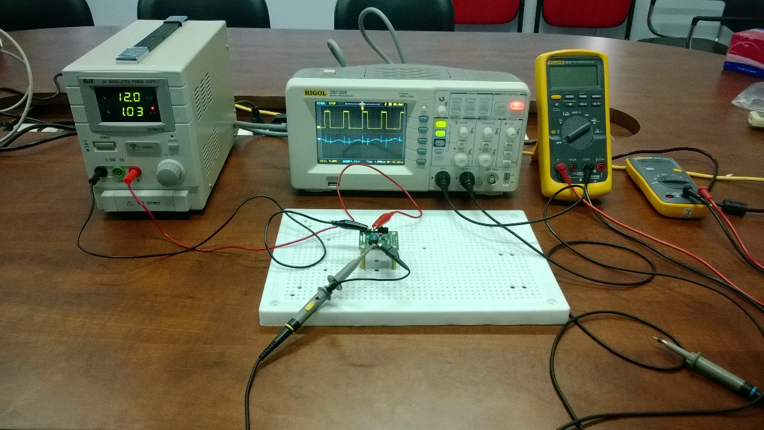
Equipment list
Regulated DC Power Supply
QJE QJ3005XE (0-30V/5A).
Multimeter:
Fluke 87V True RMS.
Fluke 106.
Oscilloscope
Rigol DS1102E.
Electronic Load
B&K BK8500.
Current probe
RP1001C.

Slide 3
Functional Test
Test case 1 procedure with electronic load BK8500
Turn on the DC Supply. Set output of the DC Supply in range from 6V to 28V and turn it off. Connect DC the Supply to: [+]V_{IN}(TP1) and [-]GND(TP2) of evaluation board.
Connect Electronic Load to: [+]V_{OUT}(TP3) and [-]GND(TP4). Power on Electronic Load, set input of Electronic Load to 1.2A.
Turn on the DC Supply.
Turn on load.
Move header J1 to turn EN on.
Result:
V_{IN} = 6V to 28V.
Vout = 0V/ 0.02A. Test fail.
The output current with electronic load BK8500 exceed ~1.75A that cause OCP (over current protection) active and shut down IC. See next slide for output current measurement.

Slide 4
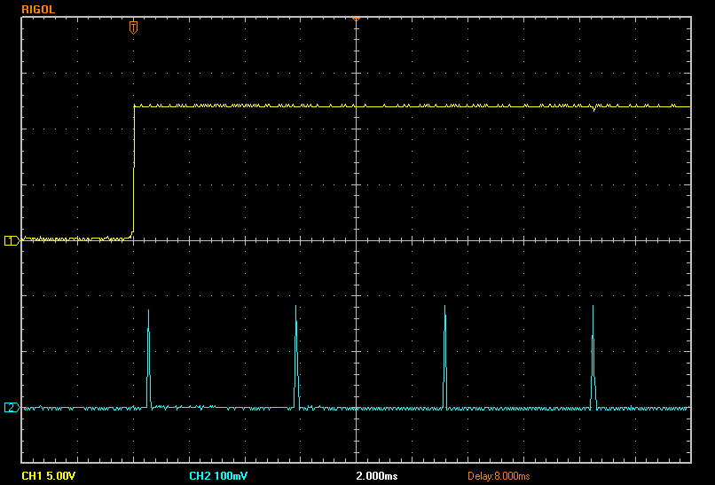
Functional Test (cont.)
V_{EN} 5V/Div. (DC)
Output current ~1.75A which cause OCP active and shut down IC
I_{OUT} 1A/Div. (DC)
Time 2ms/Div.

Slide 5
Functional Test (cont.)
Test case 2 procedure with power resistor load 4.6 Ohms:
Turn on the DC Supply. Set output of the DC Supply in range from 6V to 28V and turn it off. Connect DC the Supply to: [+]V_{IN}(TP1) and [-]GND(TP2) of evaluation board.
Connect 4.6 Ohm Resistor to: [+]V_{OUT}(TP3) and [-]GND(TP4).
Turn on the DC Supply.
Move header J1 to turn EN on.
Result:
V_{IN} = 6V to 28V.
Vout = 4.95V/ 1.1A. Test pass.
No output current glitch with power resistor load 4.6 Ohms. So the OCP is not active like test case 1. See next slide for measurement result
9/22/2014
PTH Solutions Confidential
5

Slide 6
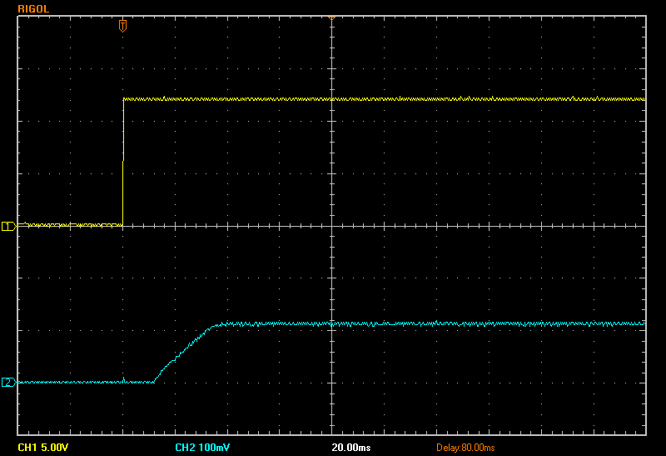
Functional Test (cont.)
V_{EN} 5V/Div. (DC)
I_{OUT} 1A/Div. (DC)
Time 20ms/Div.

Slide 7
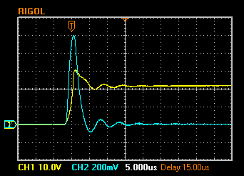
Hot Plugging Test
Test case 1
V_{IN} = 22V.
I_{OUT} = 1.2A.
With diode D2: SMAJ20A.
Result:
I_{IN_MAX}= 99.2A.
V_{IN} peak transient voltage is 31V > V_{IN} Maximum Rating (30V). Test fail
V_{IN} 10V/Div. (DC)
I_{IN} 20A/Div. (AC)
Time 5us/Div.

Slide 8
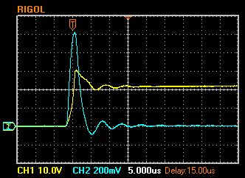
Hot Plugging Test( Cont.)
Test case 2
V_{IN} = 22V.
I_{OUT} = 0A.
With diode D2: SMAJ20A.
Result:
I_{IN_MAX}= 102A.
V_{IN} peak transient voltage is 31V > V_{IN} Maximum Rating (30V). Test fail
V_{IN} 10V/Div. (DC)
I_{IN} 20A/Div. (AC)
Time 5us/Div.
9/22/2014
PTH Solutions Confidential
8

Slide 9
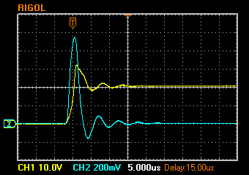
Hot Plugging Test( Cont.)
Test case 3
V_{IN} = 21V.
I_{OUT} =1.2A.
With diode D2: SMAJ22A.
Result:
I_{IN_MAX}= 94.4A.
V_{IN} peak transient voltage is 32V > V_{IN} Maximum Rating (30V). Test fail
V_{IN} 10V/Div. (DC)
I_{IN} 20A/Div. (AC)
Time 5us/Div.
9/22/2014
9/22/2014
PTH Solutions Confidential
PTH Solutions Confidential
9
9

Slide 10
Circuit Quiescent Current Measurement
Test condition
V_{IN} = 0-28V.
Room temperature 25ºC.

Slide 11
Efficiency Measurements
Test condition
V_{IN} = 12V.
V_{OUT} = 5V.
With SMAJ26A.
Room temperature 25ºC.

Slide 12
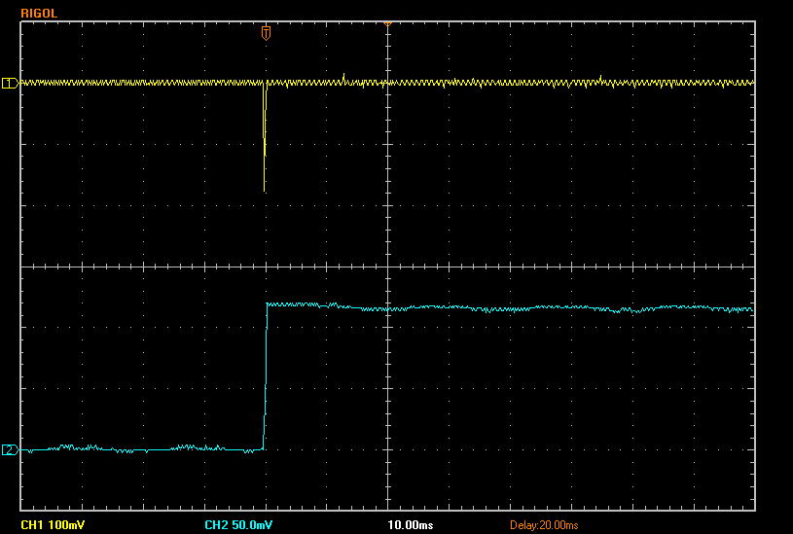
Load Response Measurements
Load response characteristic
(V_{IN}=12V, V_{OUT}=5V, I_{OUT}=0A → 1.2A)
V_{OUT} 100mV/Div. (AC)
I_{OUT} 0.5A/Div. (DC)
Time 10ms/Div.

Slide 13
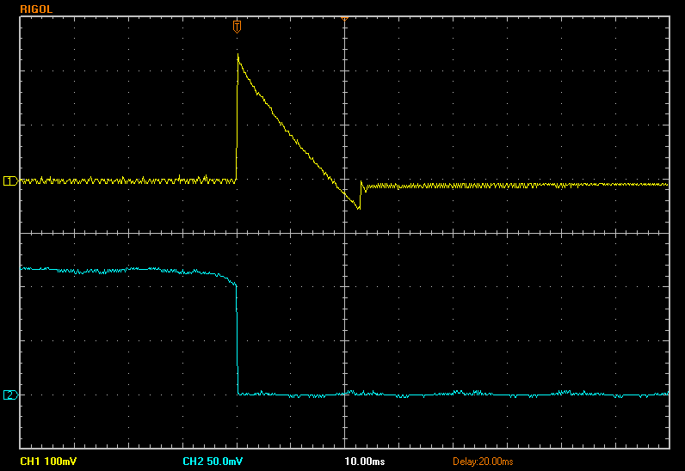
Load Response Measurements (cont.)
Load response characteristic
(V_{IN}=12V, V_{OUT}=5V, I_{OUT}=1.2A → 0A
V_{OUT} 100mV/Div. (AC)
I_{OUT} 0.5A/Div. (DC)
Time 10ms/Div.

Slide 14
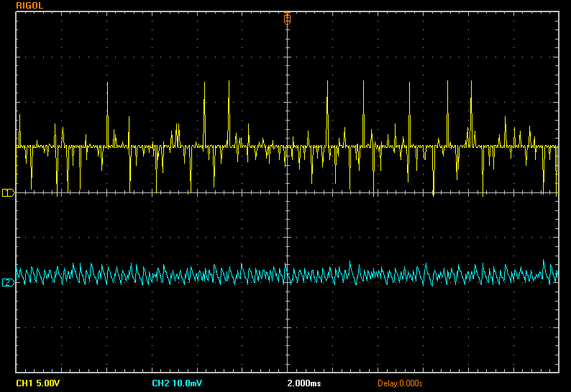
Ripple Response Measurements
V_{OUT} Ripple voltage
(V_{IN}=12V, V_{OUT}=5V, I_{OUT}=0A)
V_{SW} 5V/Div. (DC)
V_{OUT} 10mV/Div. (AC)
Time 2ms/Div.

Slide 15
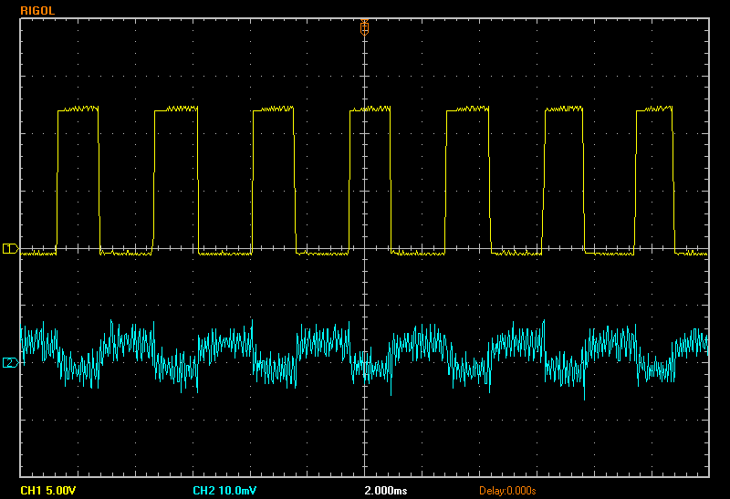
Ripple Response Measurements (cont.)
V_{OUT} Ripple voltage
(V_{IN}=12V, V_{OUT}=5V, I_{OUT}=1.2A
V_{SW} 5V/Div. (DC)
V_{OUT} 10mV/Div. (AC)
Time 2ms/Div.

